Slide 1
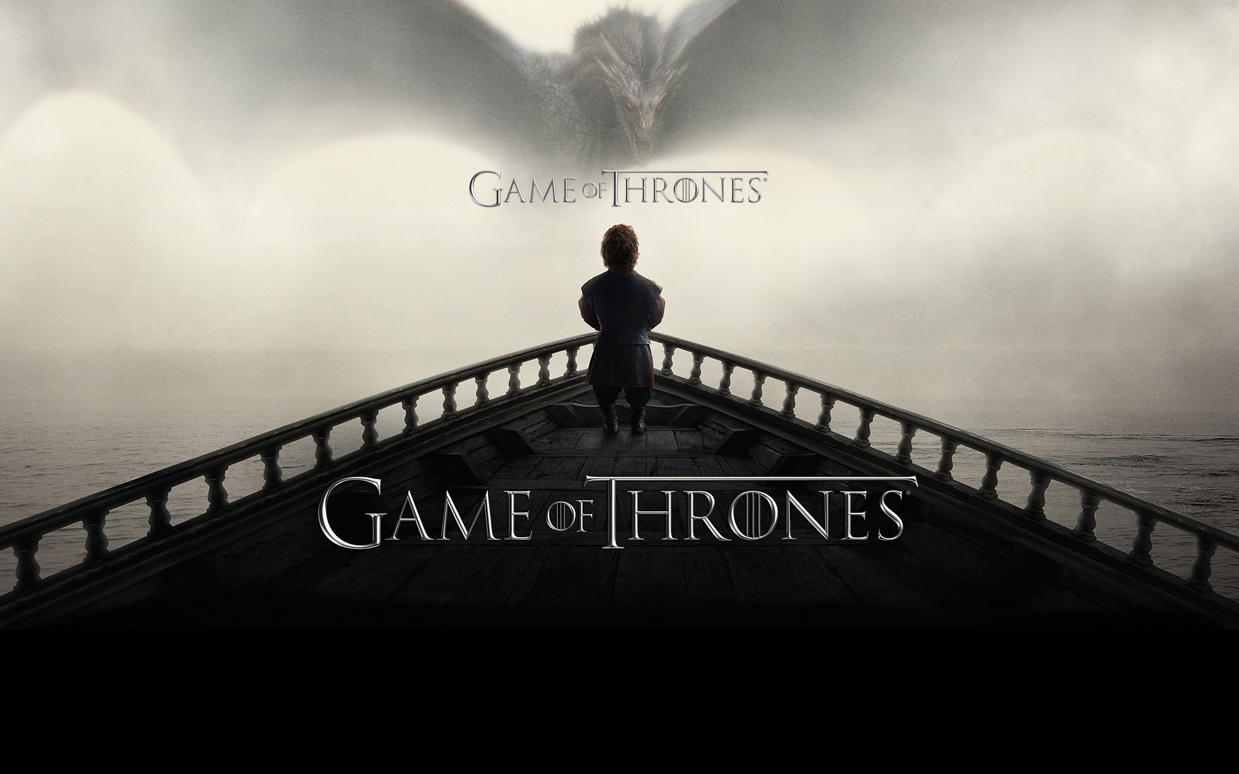

Slide 2
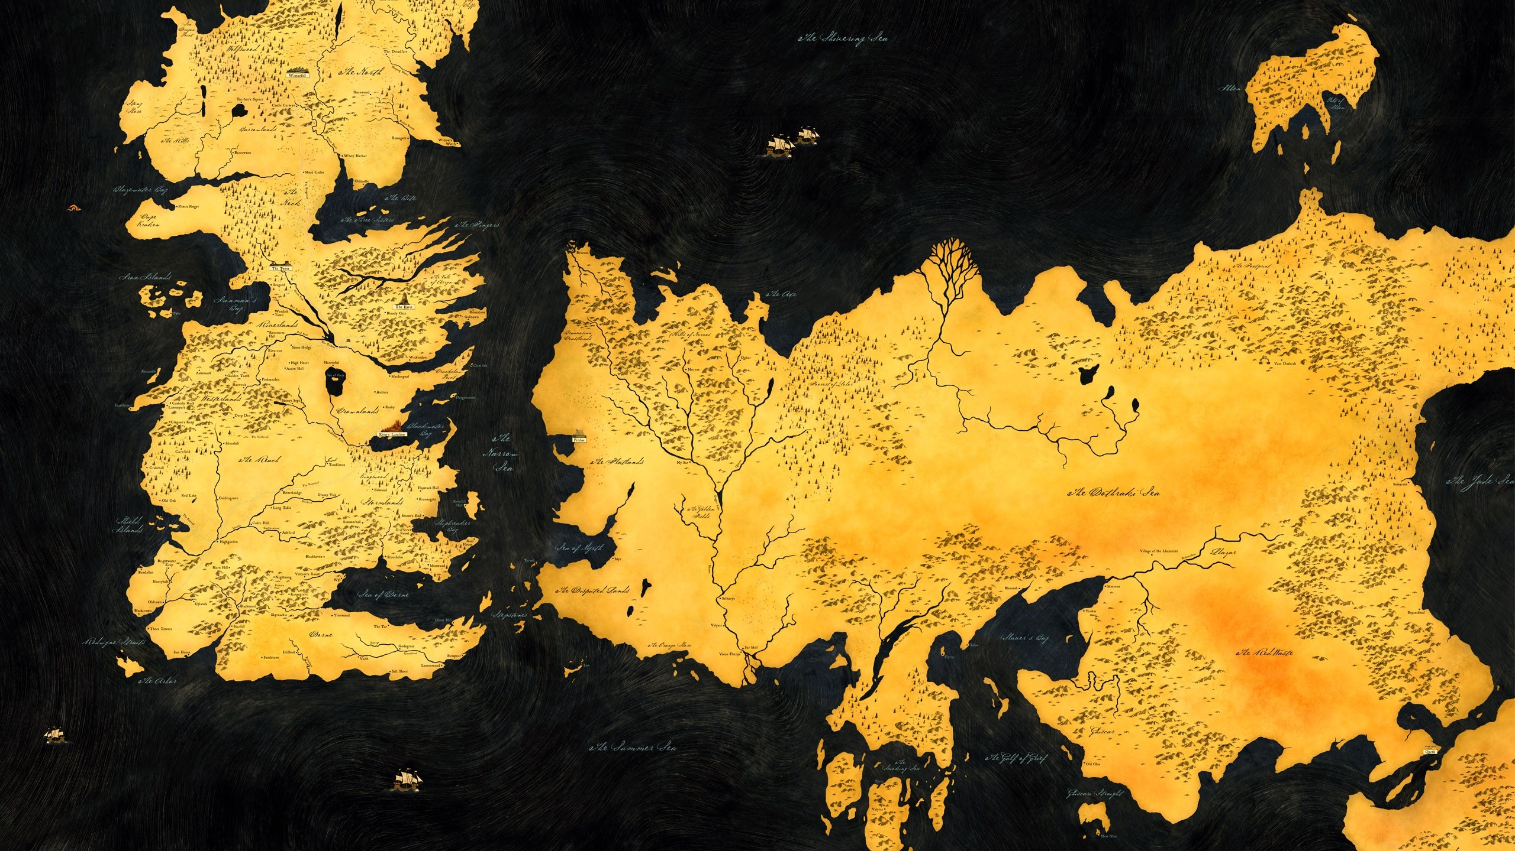
World Map
Virtual World of Game of Throne

Slide 3
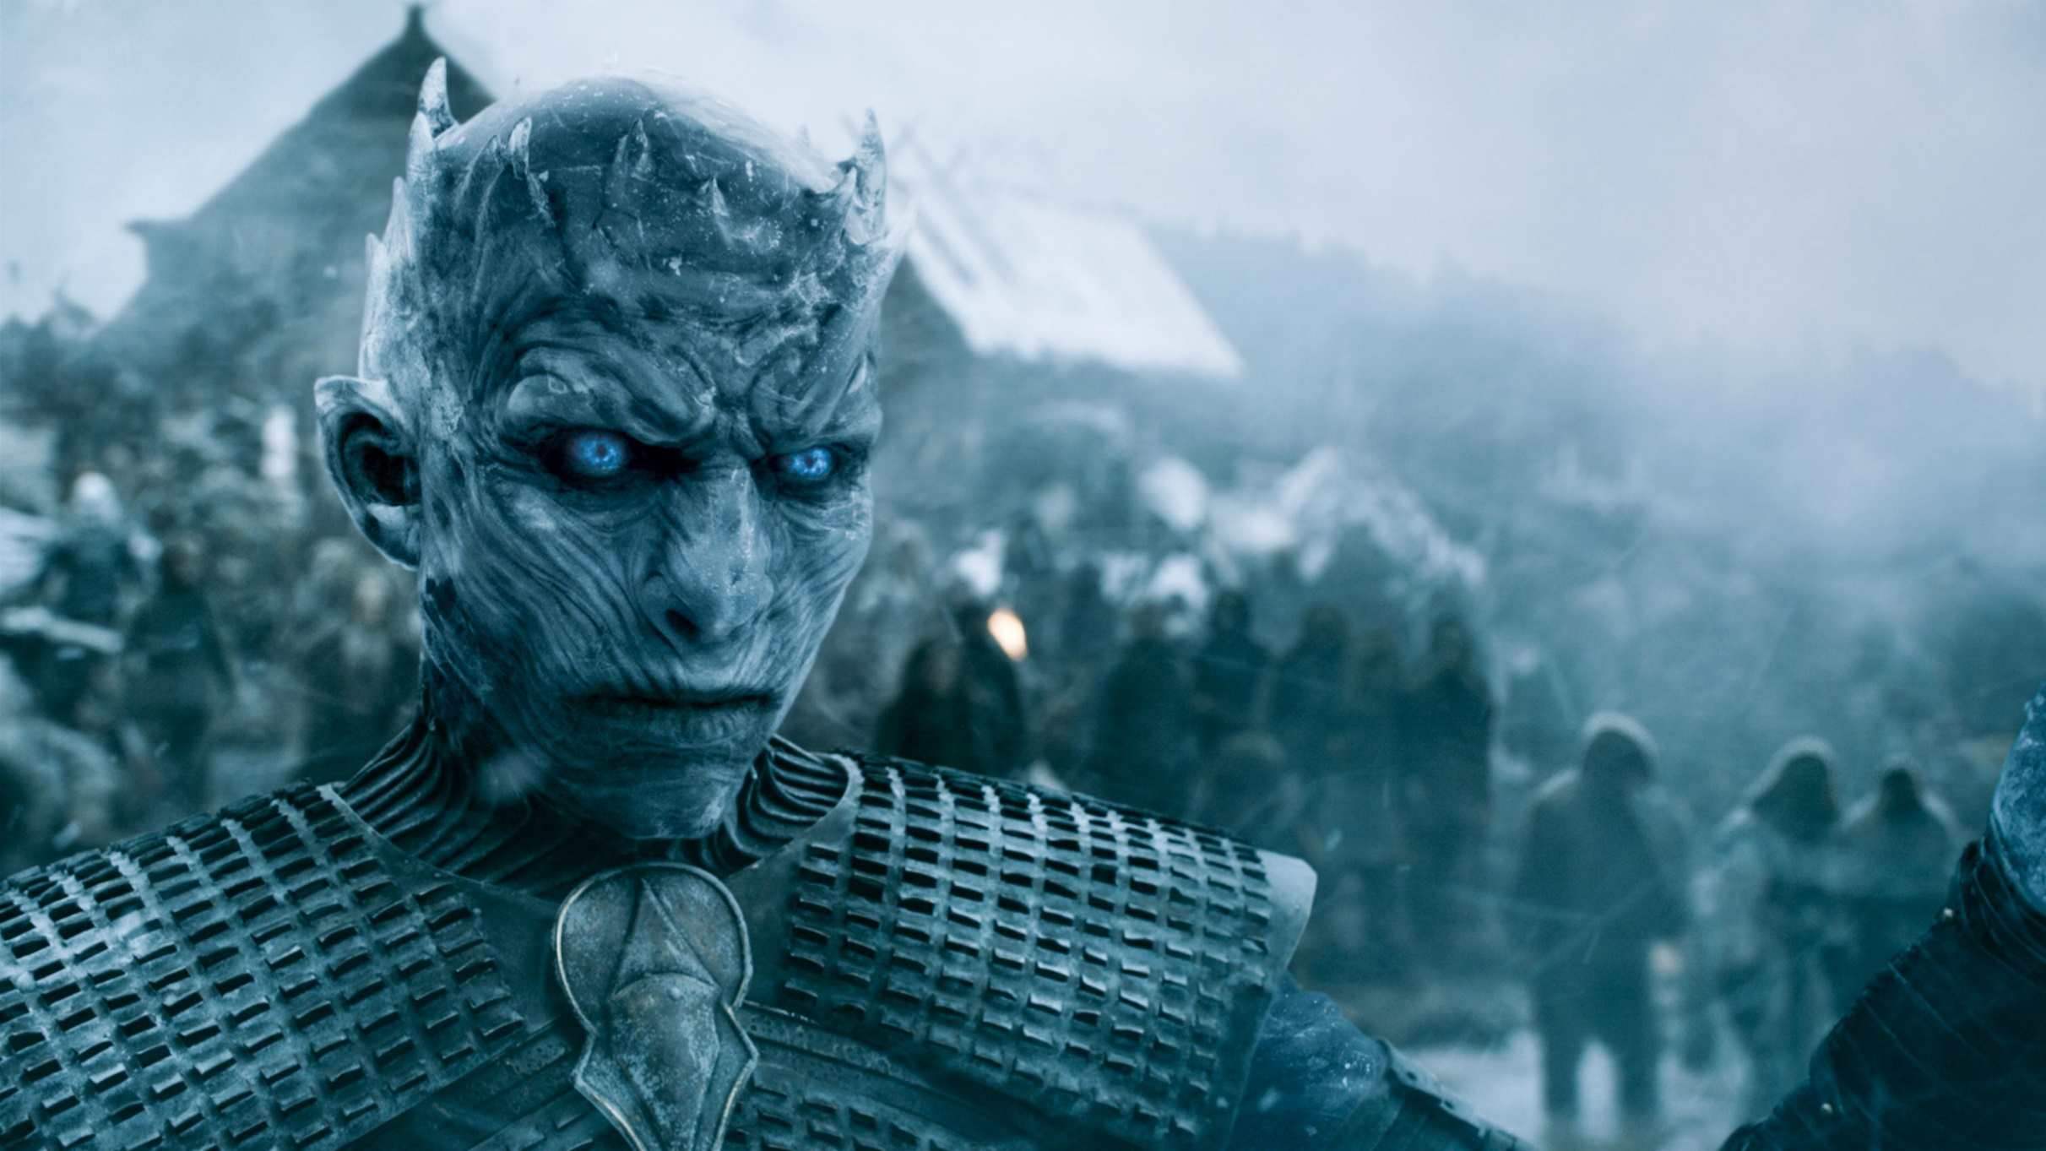
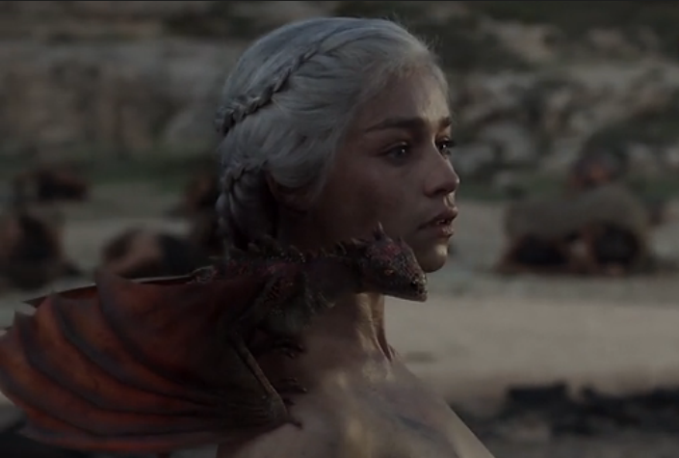
Dragons
Born under a coincident circumstances
White Walkers
Creature lived North of the land

Slide 4
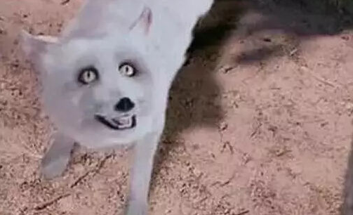
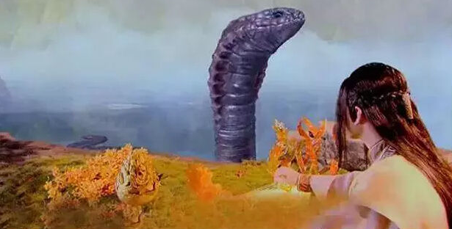

Slide 5
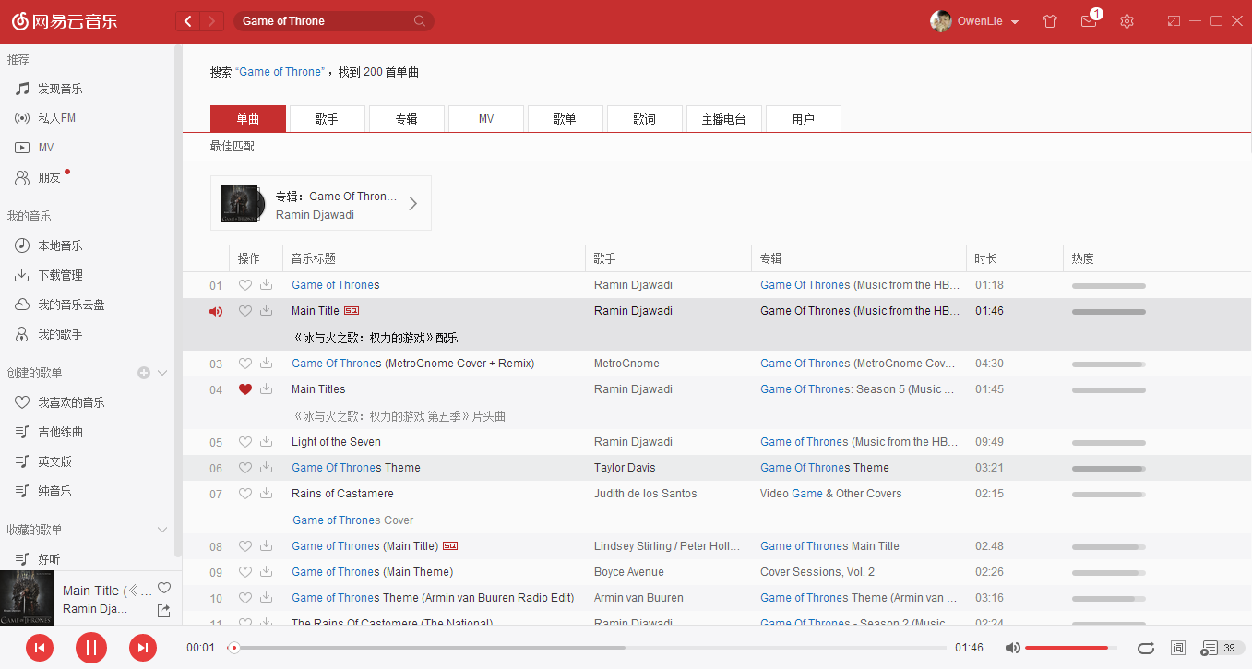
Music
Plenty of interlude songs in the series

Slide 6
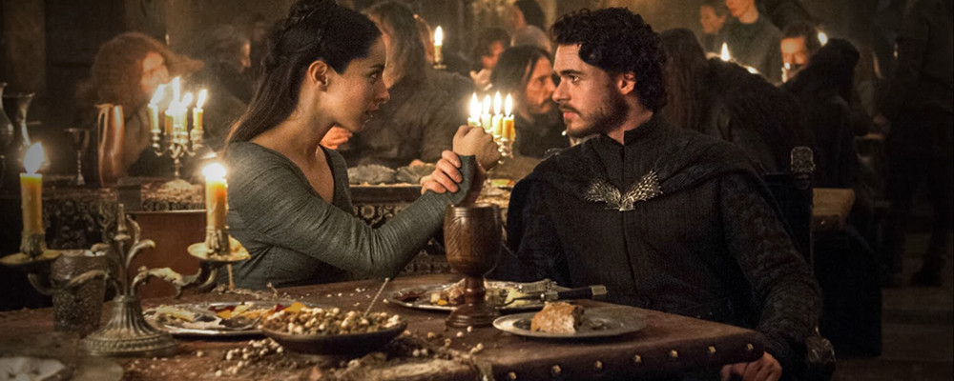
Red Wedding
Members of Stark and army from North are all slaughtered

